Slide 1
Tutorial No. 4

Slide 2
Priority – Preemptive & Non-preemptive with I/O
Process | Arrival Time | Execution Time | Priority
A | 0 | 7 | 3
B | 2 | 9 | 1
C | 4 | 6 | 2
D | 6 | 8 | 0
Assume process A goes for I/O for 5 units of time after every 3 unit execution in CPU
Assume B goes for I/O for 2 units after 5 units of execution in CPU
Process C is a CPU bound process with no I/O
Process D goes for I/O for 1 unit after 4 units of execution in CPU.

Slide 3
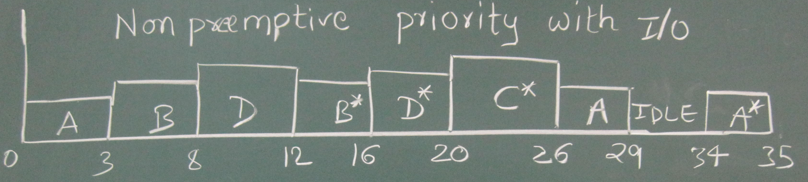
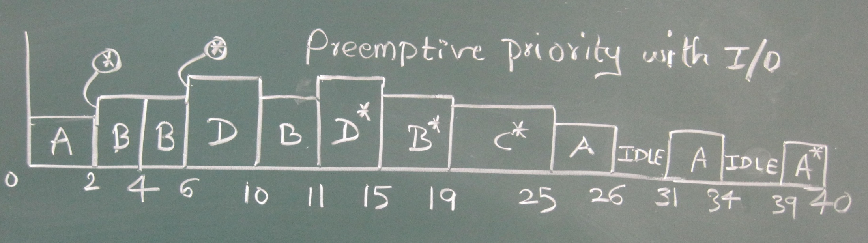
13

Slide 4
Multilevel Feedback with I/O
Assume process A goes for I/O for 5 units of time after every 3 unit execution in CPU
Assume B goes for I/O for 2 units after 5 units of execution in CPU
Process C is a CPU bound process with no I/O
Process D goes for I/O for 1 unit after 4 units of execution in CPU.
Process | Arrival Time | Execution Time
A | 0 | 7
B | 2 | 9
C | 4 | 6
D | 6 | 8
Queue Q_{i} has processes with time quantum 2^{i .}
^{Process always enters in Q}₀ initially and after completing I/O.
If a process is preempted by a process in higher priority queue, process remains is the same queue at same position(i.e at head of the queue) with remaining time quantum.

Slide 5
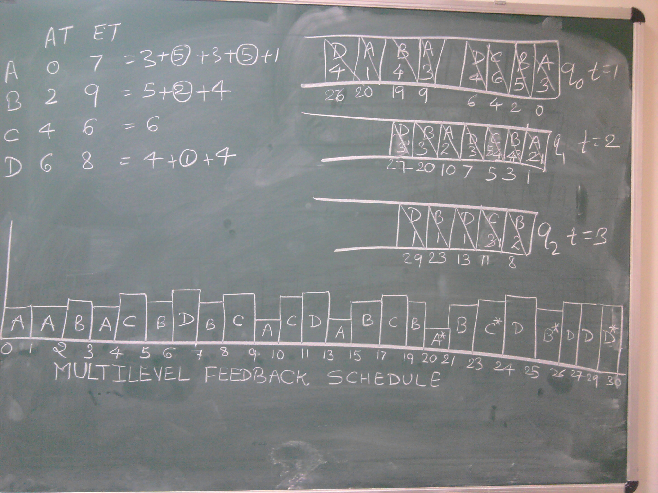
t=4

Slide 6
Multilevel Feedback without I/O
Process | Arrival Time | Execution Time
A | 0 | 3
B | 2 | 6
C | 4 | 4
D | 6 | 5
E | 8 | 2
Queue Q₀ has processes with time quantum=1 .
Queue Q₁ has processes with time quantum=2
Queue Q₂ has processes with time quantum=3
^{Process always enters in Q}₀ ^{initially.}
If a process is preempted by a process in higher priority queue, process remains is the same queue at same position(i.e at head of the queue) with remaining time quantum.

Slide 7
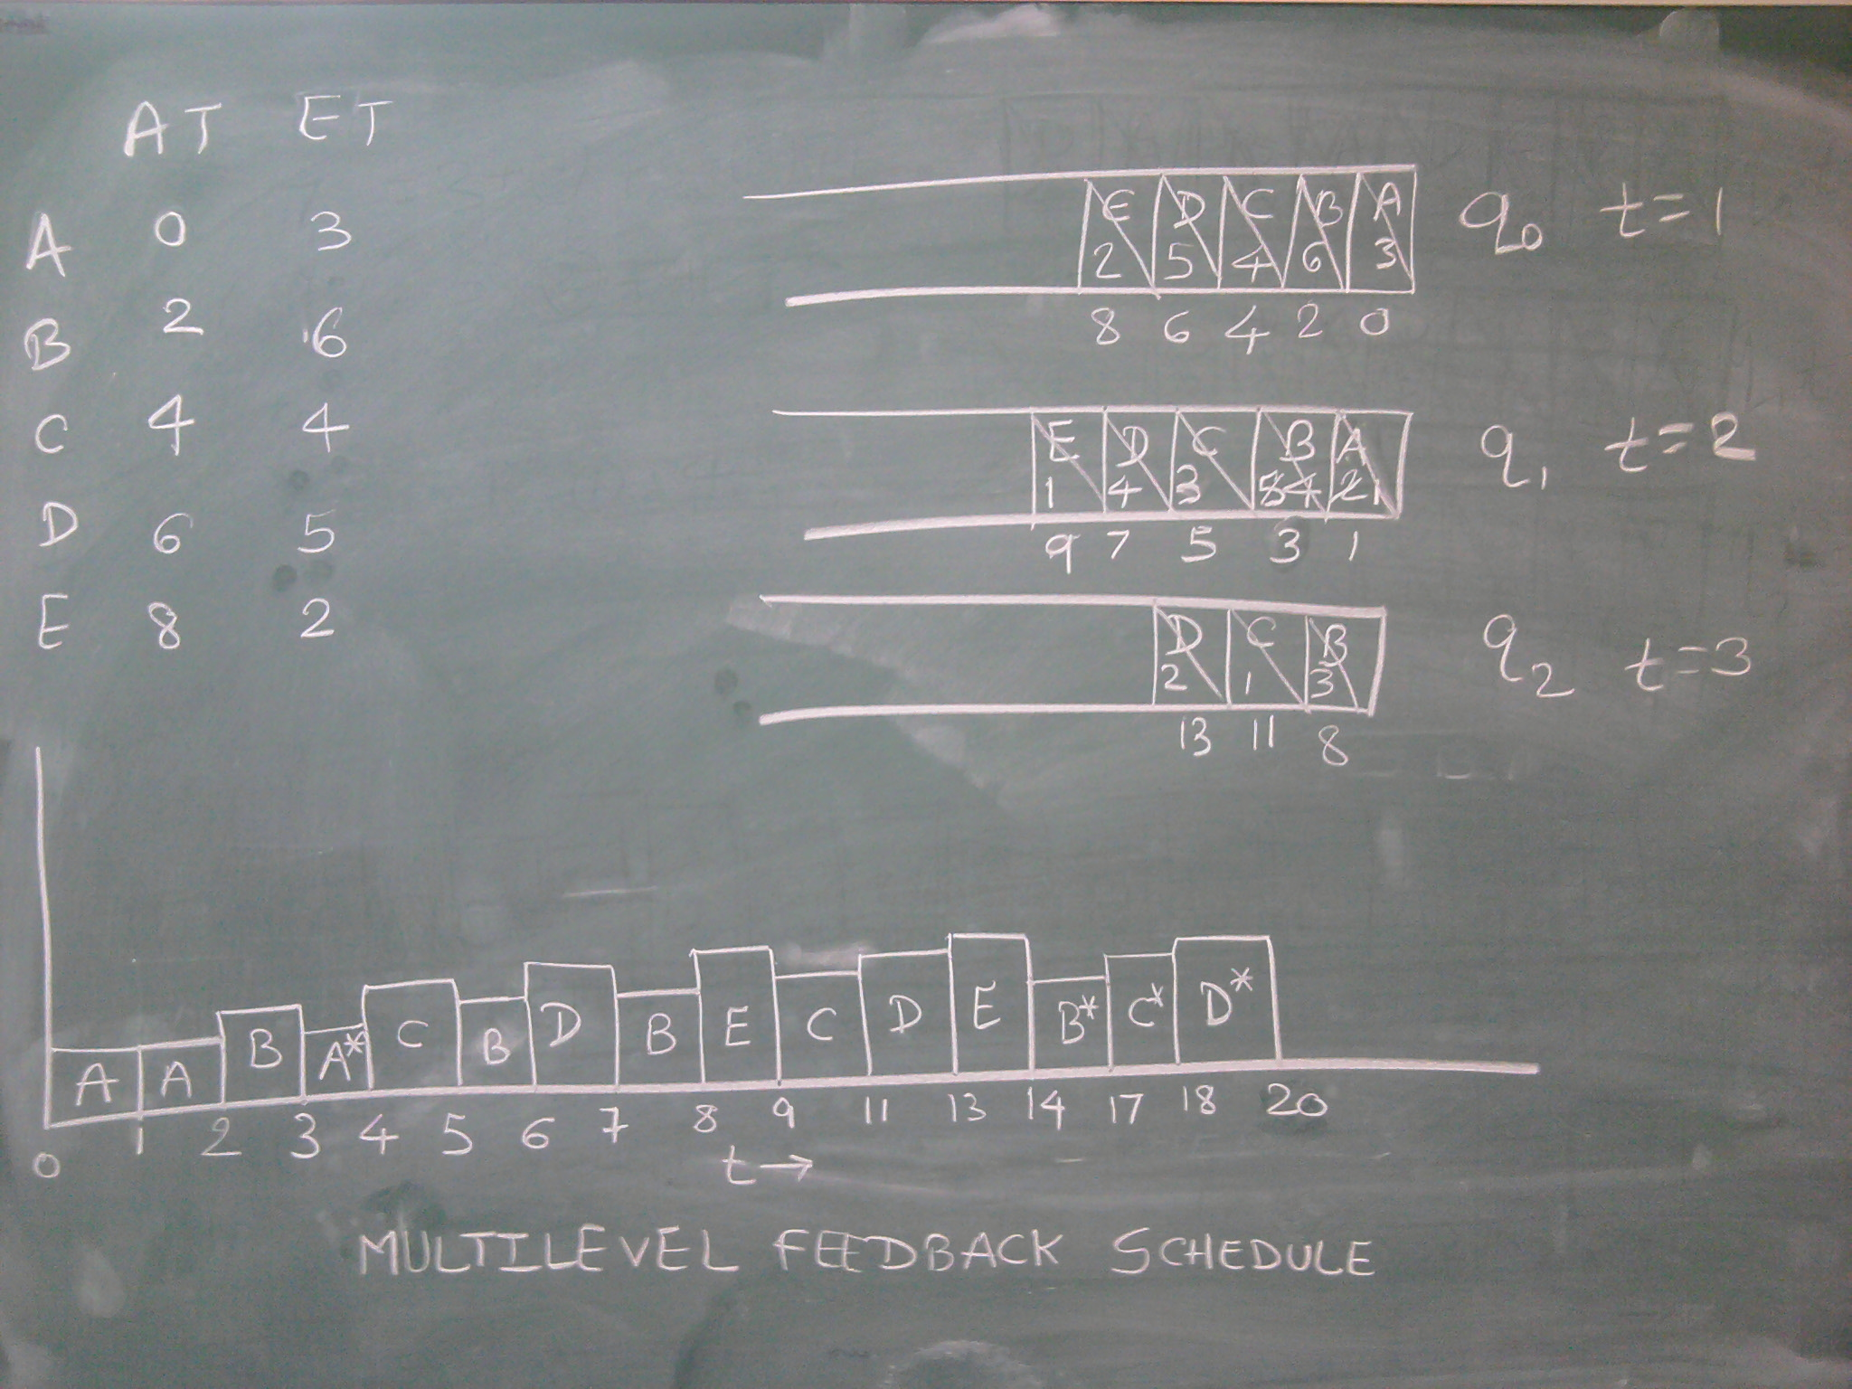

Slide 8
Exercise : FSS
A system has 4 processes P0 to P3.
They are divided into 2 groups G1 and G2 with 25% and 75% weight respectively.
G1 has 3 processes [P0, P1 and P2] in the group and G2 has a single process [P3] in the group.
The base priorities of processes P0 to P3 are 33, 26, 25 and 27 respectively.
The scheduler will be called for decision making after every 20 units OR current process termination.
All the processes other than P2 are CPU bound processes with no I/O.
Execution time for process P0 is 40 units.
Execution time for process P1 is 40 units.
Process P2 executes 40 units in CPU then goes for I/O for 40 units and comes back executes the remaining 20 units.
Process P3 executes 60 units in CPU.
After an I/O when a process returns to ready state, its priority is recomputed by using the base priority and group count. The CPU count of that process is considered as zero.
Solve the scheduling problem using Fair Share scheduling algorithm. Make sure you are mentioning priority, CPU count and group count at each decision point.

Slide 9
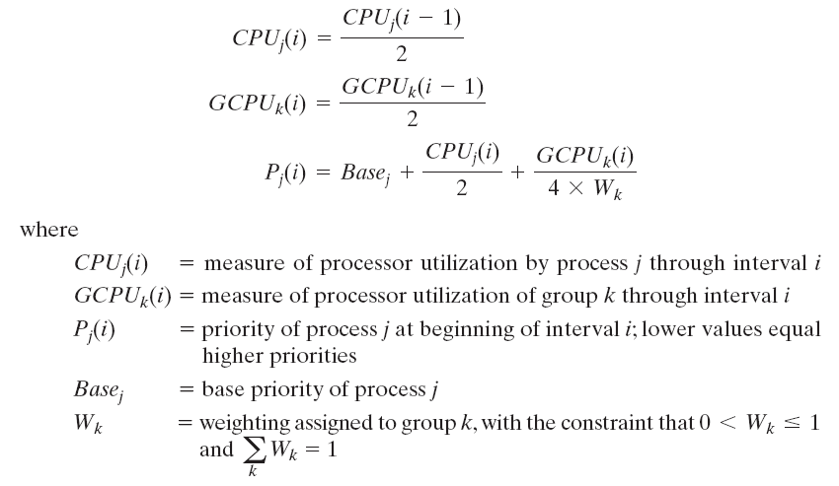
Priority calculation
The following formulas apply for process j in group k:
Notes:
FSS considers the execution history of a related group of processes, along with the individual execution history of each process in making scheduling decisions.
Scheduling is done on the basis of priority.
Each process is assigned a priority which takes into account the base priority of the process, its recent processor usage, and the recent processor usage of the group to which the process belongs.
The higher the numerical value of the priority, the lower the priority.
The following formulas apply for process j in group k:
The priority of a process drops as the process uses the processor and as the group to which the process belongs uses the
processor. In the case of the group utilization, the average is normalized by dividing by the weight of that group.
The greater the weight assigned to the group, the less its utilization will affect its priority.

Slide 10
P0 |  |  | P1 |  |  | P2 |  |  | P3
Prio | Cpu count | Group count | Prio | Cpu count | Group count | Prio | Cpu count | Group count | Prio | Cpu count | Group count
33 | 0 | 0 | 26 | 0 | 0 | 25 | 0 | 0 | 27 | 0 | 0
 | 0 | 20 |  | 0 | 20 |  | 20 | 20 |  | 0 | 0
43 | 0 | 10 | 36 | 0 | 10 | 40 | 10 | 10 | 27 | 0 | 0
 | 0 | 10 |  | 0 | 10 |  | 10 | 10 |  | 20 | 20
38 | 0 | 5 | 31 | 0 | 5 | 32 | 5 | 5 | 35 | 10 | 10
 | 0 | 25 |  | 20 | 25 |  | 5 | 25 |  | 10 | 10
45 | 0 | 12 | 43 | 10 | 12 | 38 | 2 | 12 | 30 | 5 | 5
 | 0 | 12 |  | 10 | 12 |  | 2 | 12 |  | 25 | 25
39 | 0 | 6 | 34 | 5 | 6 | 31 | 1 | 6 | 37 | 12 | 12
 | 0 | 26 |  | 5 | 26 |  | 21 | 26 |  | 12 | 12
46 | 0 | 13 | 40 | 2 | 13 | 43 | 10 | 13 | 33 | 6 | 6
 |  |  |  |  |  |  | I/O |  |  | *
 | 0 | 13 |  | 2 | 13 |  | 10 | 13 |  | 26 | 26

Slide 11
P0 |  |  | P1 |  |  | P2 |  |  | P3
Prio | Cpu count | Group count | Prio | Cpu count | Group count | Prio | Cpu count | Group count | Prio | Cpu count | Group count
39 | 0 | 6 | 32 | 1 | 6 |  | 5 | 6
 |  |  |  | * |  |  | I/O
 | 0 | 26 |  | 21 | 26
36 | 0 | 13 |  |  |  | 28 | 0 | 13
 |  |  |  |  |  |  | *
 | 0 | 33 |  |  |  |  | 20 | 33
37 | 0 | 16
 | 20 | 36
42 | 10 | 18
 | *
 | 30 | 38

